Slide 1
Chapter 2 – Software Processes
CS 425 September 5, 2024
Ian Sommerville,
Software Engineering, 10th Edition
Pearson Education, Addison-Wesley
Note: These are a slightly modified version of Chapter 2 slides available from the author’s site http://iansommerville.com/software-engineering-book/
Chapter 2 Software Processes

Slide 2
Topics covered
Software process models
Process activities
Coping with change
Process improvement
Chapter 2 Software Processes

Slide 3
The software process
Software process: a structured set of activities required to develop a software system
Many different software processes but all involve:
Specification – defining what the system should do;
Design and implementation – defining the organization of the system and implementing the system;
Validation – checking that it does what the customer wants;
Evolution – changing the system in response to changing customer needs.
A software process model is an abstract representation of a process. It presents a description of a process from some particular perspective.
Chapter 2 Software Processes
Notes:
The software process can be different between companies based on the software being developed, the requirements of the customer, and the skills of the people writing the software. Most companies develop their own software processes tailored to the individual needs.

Slide 4
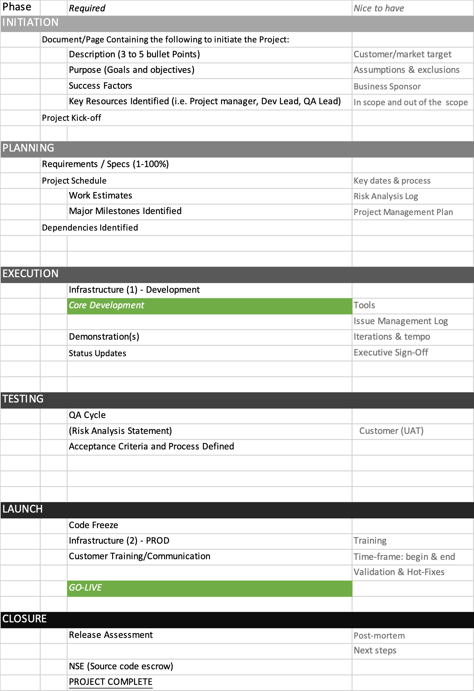
Chapter 2 Software Processes
Notes:
When we describe and discuss processes, we usually talk about the activities in these processes such as specifying a data model, designing a user interface, etc. and the ordering of these activities.
Process descriptions may also include:
Products, which are the outcomes of a process activity;
Roles, which reflect the responsibilities of the people involved in the process;
Pre- and post-conditions, which are statements that are true before and after a process activity has been enacted or a product produced.

Slide 5
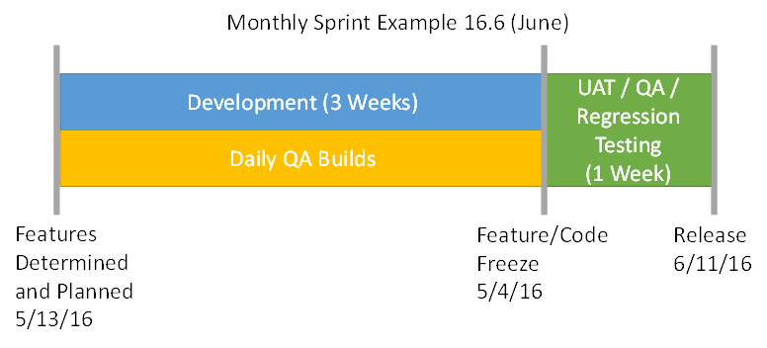
Sprint Example
Chapter 2 Software Processes

Slide 6
Plan-driven and agile processes
Plan-driven processes are processes where all of the process activities are planned in advance and progress is measured against this plan.
In agile processes, planning is incremental and it is easier to change the process to reflect changing customer requirements.
In practice, most practical processes include elements of both plan-driven and agile approaches.
There are no right or wrong software processes.
Chapter 2 Software Processes

Slide 7
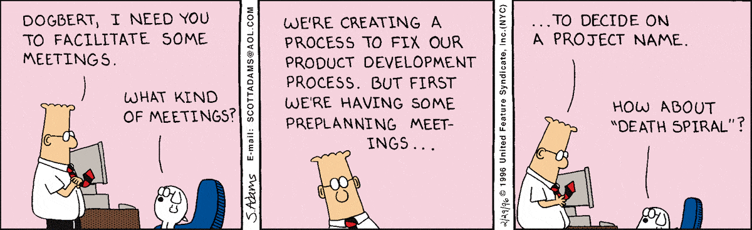
Software process models
Chapter 2 Software Processes

Slide 8
Software process models
The waterfall model (1)
Plan-driven model. Separate and distinct phases of specification and development.
Incremental development (2)
Specification, development and validation are interleaved. May be plan-driven or agile.
Integration and configuration (3)
The system is assembled from existing configurable components. May be plan-driven or agile.
In practice, most large systems are developed using a process that incorporates elements from all of these models.
Chapter 2 Software Processes

Slide 9
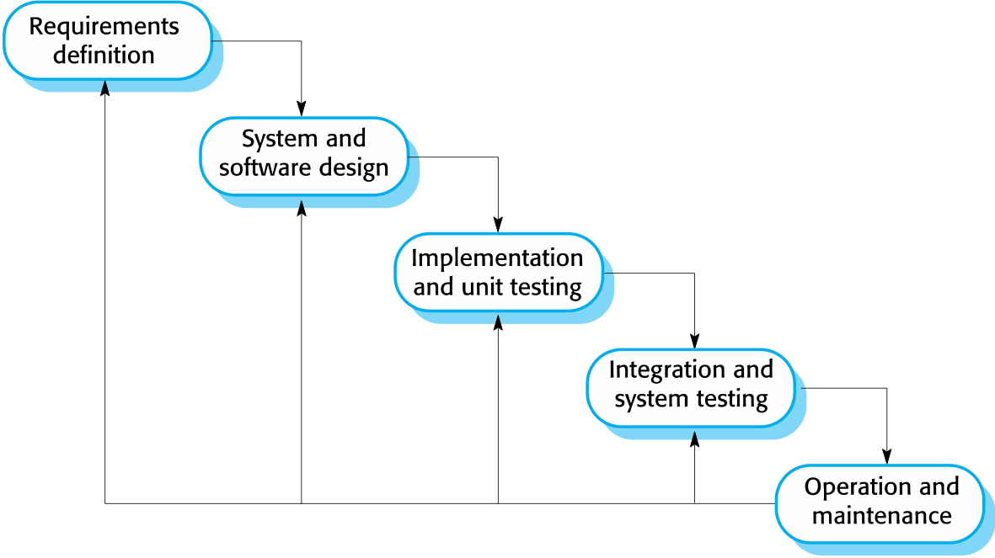
The waterfall model
Chapter 2 Software Processes

Slide 10
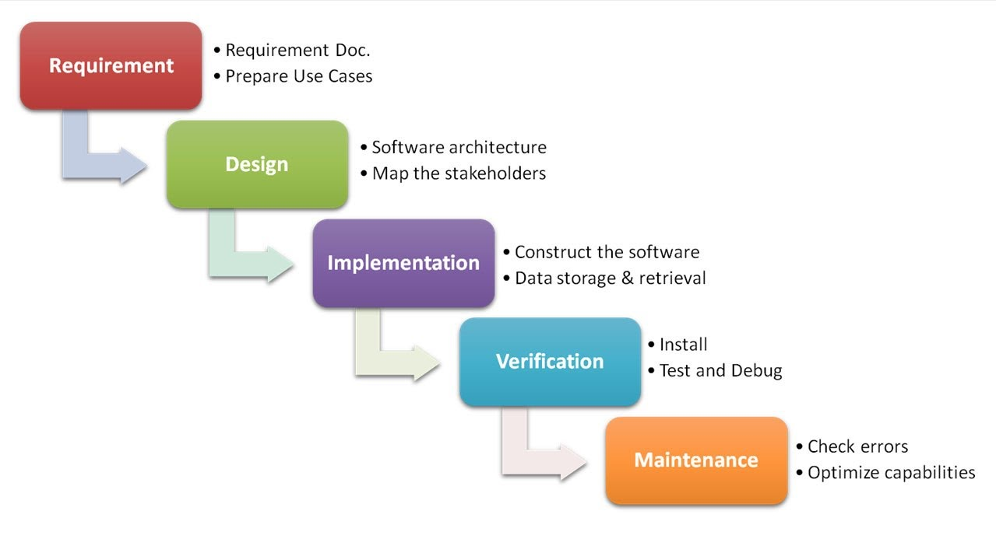
The waterfall model Phases
Chapter 2 Software Processes
Notes:
There are separate identified phases in the waterfall model:
Requirements analysis and definition
System and software design
Implementation and unit testing
Integration and system testing
Operation and maintenance
The main drawback of the waterfall model is the difficulty of accommodating change after the process is underway. In principle, a phase has to be complete before moving onto the next phase.

Slide 11
Waterfall model problems
Inflexible partitioning of the project into distinct stages makes it difficult to respond to changing customer requirements.
Therefore, this model is only appropriate when the requirements are well-understood and changes will be fairly limited during the design process.
Few business systems have stable requirements.
The waterfall model is mostly used for large systems engineering projects where a system is developed at several sites.
In those circumstances, the plan-driven nature of the waterfall model helps coordinate the work.
Chapter 2 Software Processes

Slide 12
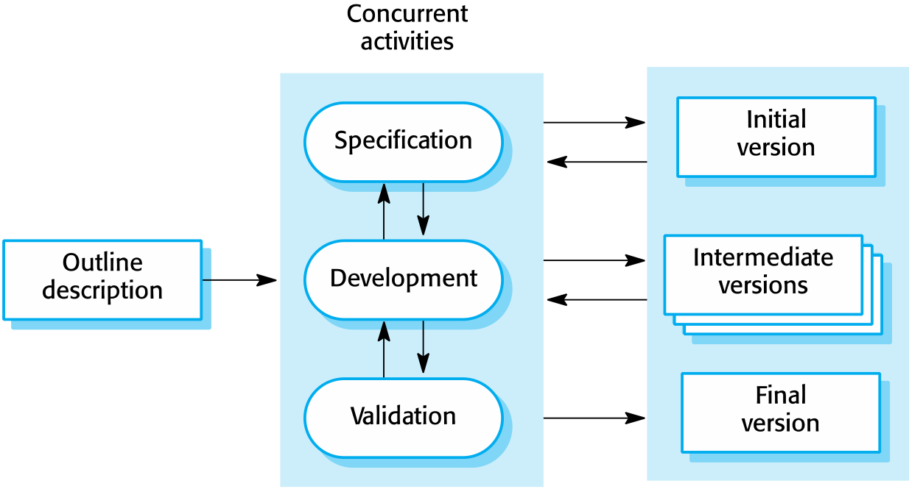
Incremental development
Chapter 2 Software Processes
Notes:
Delivery of functionality in incremental phases or versions

Slide 13
Incremental development benefits
The cost of accommodating changing customer requirements is reduced
The amount of analysis and documentation that has to be redone is much less than is required with the waterfall model
It is easier to get customer feedback on the development work that has been done
Customers can comment on demonstrations of the software and see how much has been implemented
More rapid delivery and deployment of useful software to the customer is possible
Customers are able to use and gain value from the software earlier than is possible with a waterfall process
Chapter 2 Software Processes

Slide 14
Incremental development problems
The process is not visible
Managers need regular deliverables to measure progress. If systems are developed quickly, it is not cost-effective to produce documents that reflect every version of the system
System structure tends to degrade as new increments are added
Unless time and money is spent on refactoring to improve the software, regular change tends to corrupt its structure. Incorporating further software changes becomes increasingly difficult and costly
Chapter 2 Software Processes

Slide 15
Integration and configuration
Based on software reuse where systems are integrated from existing components or application systems (COTS - commercial-off-the-shelf).
Reused elements may be configured to adapt their behaviour and functionality to a user’s requirements
Reuse is now the standard approach for building many types of business system
Reuse covered in more depth in Chapter 15
Chapter 2 Software Processes

Slide 16
Types of reusable software
Stand-alone application systems (sometimes called COTS) that are configured for use in a particular environment.
Collections of objects that are developed as a package to be integrated with a component framework such as .NET or J2EE.
Web services that are developed according to service standards and which are available for remote invocation.
30/10/2014
Chapter 2 Software Processes

Slide 17
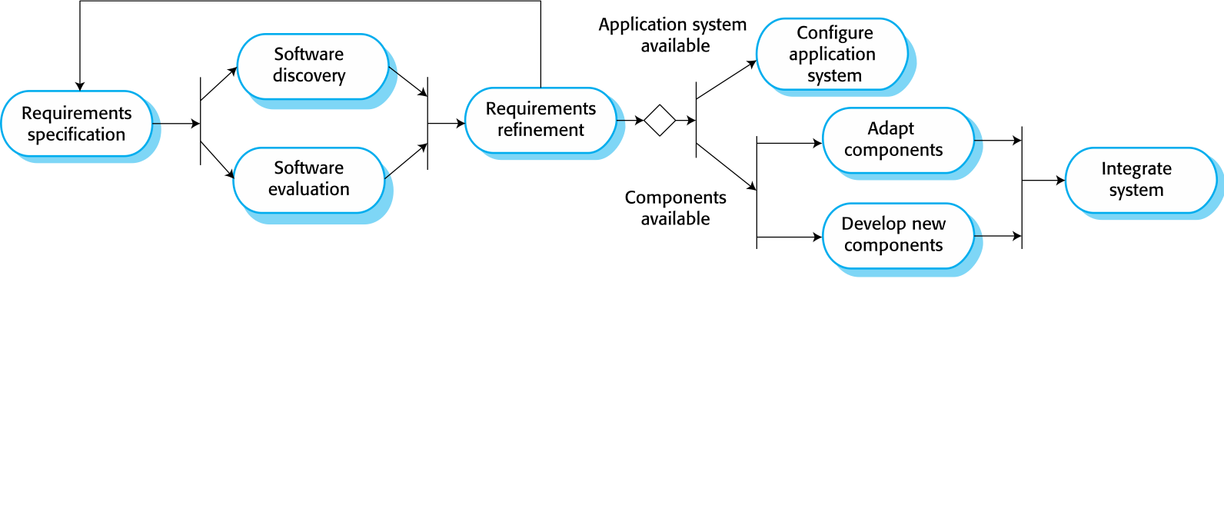
Reuse-oriented software engineering
Chapter 2 Software Processes

Slide 18
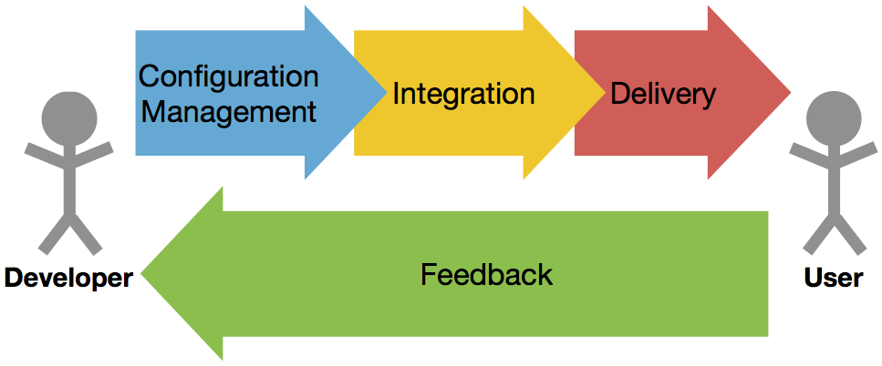
Integration and configuration Simplified
Chapter 2 Software Processes

Slide 19
Key process stages
Requirements specification
Software discovery and evaluation
Requirements refinement
Application system configuration
Component adaptation and integration
Chapter 2 Software Processes

Slide 20
Advantages and disadvantages
Reduced costs and risks as less software is developed from scratch
Faster delivery and deployment of system
But requirements compromises are inevitable so system may not meet real needs of users
Loss of control over evolution of reused system elements
Chapter 2 Software Processes

Slide 21
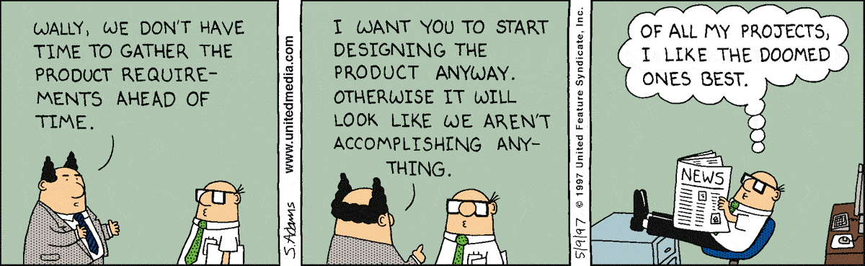
Process activities
Chapter 2 Software Processes

Slide 22
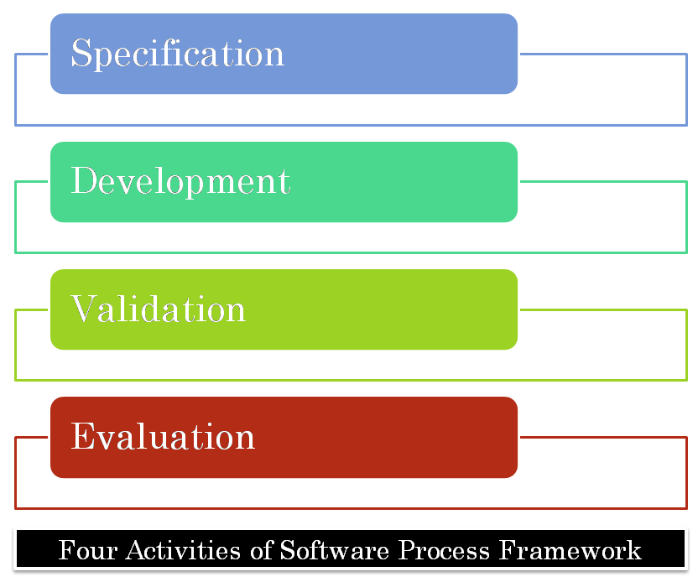
Process activities
Chapter 2 Software Processes
Notes:
Real software processes are inter-leaved sequences of technical, collaborative and managerial activities with the overall goal of specifying, designing, implementing and testing a software system
The four basic process activities of specification, development, validation and evolution are organized differently in different development processes
For example, in the waterfall model, they are organized in sequence, whereas in incremental development they are interleaved

Slide 23
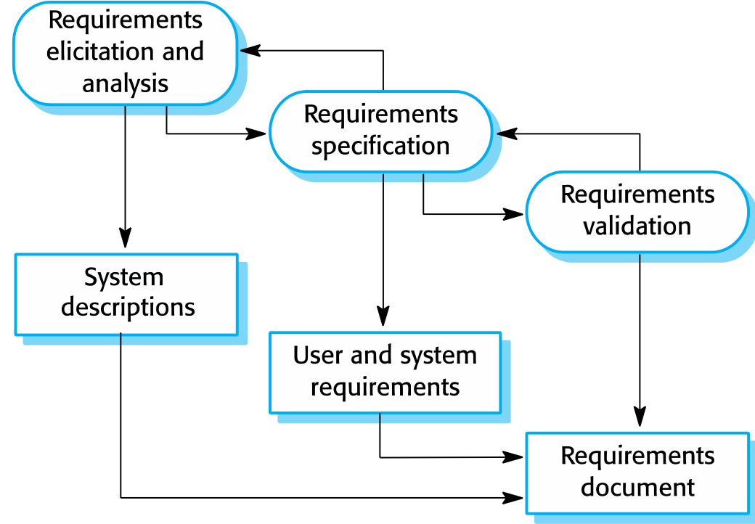
The requirements engineering process
Chapter 2 Software Processes

Slide 24
Software specification
The process of establishing what services are required and the constraints on the system’s operation and development
Requirements engineering process
Requirements elicitation and analysis
What do the system stakeholders require or expect from the system?
Requirements specification
Defining the requirements in detail
Requirements validation
Checking the validity of the requirements
Chapter 2 Software Processes

Slide 25
Software design and implementation
The process of converting the system specification into an executable system
Software design
Design a software structure that realizes the specification
Implementation
Translate this structure into an executable program
The activities of design and implementation are closely related and may be inter-leaved
Chapter 2 Software Processes

Slide 26
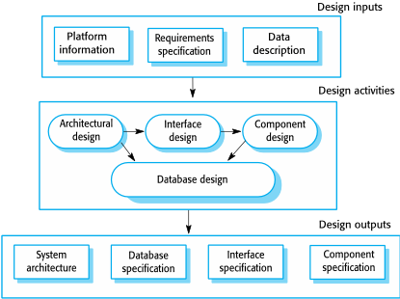
A general model of the design process
Chapter 2 Software Processes

Slide 27
Design activities
Architectural design, where you identify the overall structure of the system, the principal components (subsystems or modules), their relationships and how they are distributed
Database design, where you design the system data structures and how these are to be represented in a database
Interface design, where you define the interfaces between system components
Component selection and design, where you search for reusable components. If unavailable, you design how it will operate.
Chapter 2 Software Processes

Slide 28
System implementation
The software is implemented either by developing a program or programs or by configuring an application system
Design and implementation are interleaved activities for most types of software system
Programming is an individual activity with no standard process
Debugging is the activity of finding program faults and correcting these faults
Chapter 2 Software Processes
Notes:
Programing may have processes such as code review processes and style guides for User Interfaces

Slide 29
Software validation
Verification and validation (V & V) is intended to show that a system conforms to its specification and meets the requirements of the system customer
Involves checking and review processes and system testing
System testing involves executing the system with test cases that are derived from the specification of the real data to be processed by the system
Testing is the most commonly used V & V activity
Chapter 2 Software Processes
Notes:
Test cases are written from software specifications and can also include automated test scripts

Slide 30
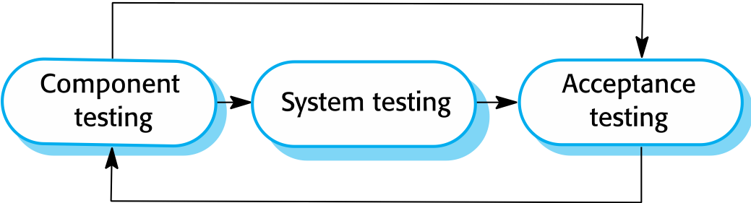
Stages of testing
Chapter 2 Software Processes

Slide 31
Testing stages
Component testing
Individual components are tested independently
Components may be functions or objects or coherent groupings of these entities
System testing
Testing of the system as a whole. Testing of emergent properties is particularly important.
Customer testing
Testing with customer data to check that the system meets the customer’s needs
Chapter 2 Software Processes
Notes:
Component testing includes testing done internally by the engineer including smoke testing
System testing is usually referred to as QA testing usually done by a separate group
Customer testing is sometimes called User Acceptance Testing and is typically done prior to a release to production

Slide 32
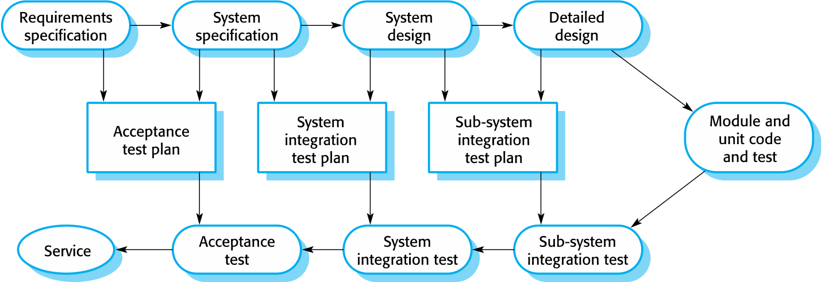
Testing phases in a plan-driven software process (V-model)
Chapter 2 Software Processes

Slide 33
Software evolution
Software is inherently flexible and can change
As requirements change through changing business circumstances, the software that supports the business must also evolve and change
Although there has been a demarcation between development and evolution (maintenance) this is increasingly irrelevant as fewer and fewer systems are completely new
Chapter 2 Software Processes

Slide 34
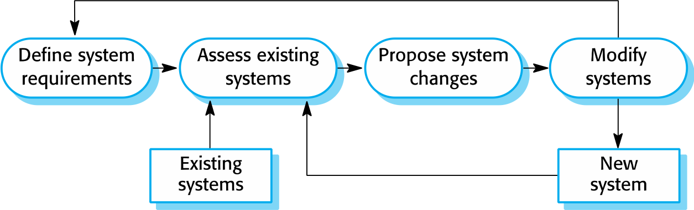
System evolution
Chapter 2 Software Processes

Slide 35
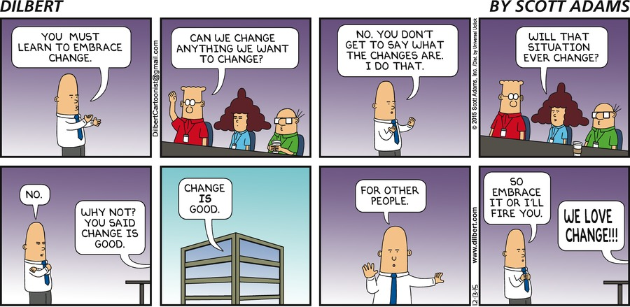
Coping with change
Chapter 2 Software Processes

Slide 36
Coping with change
Change is inevitable in all large software projects
Business changes lead to new and changed system requirements
New technologies open up new possibilities for improving implementations
Changing platforms require application changes
Change leads to rework so the costs of change include both rework (e.g., re-analyzing requirements) as well as the costs of implementing new functionality
Chapter 2 Software Processes

Slide 37
Reducing the costs of rework
Change anticipation, where the software process includes activities that can anticipate possible changes before significant rework is required
For example, a prototype system may be developed to show some key features of the system to customers
Change tolerance, where the process is designed so that changes can be accommodated at relatively low cost
This normally involves some form of incremental development. Proposed changes may be implemented in increments that have not yet been developed. If this is impossible, then only a single increment (a small part of the system) may have be altered to incorporate the change.
Chapter 2 Software Processes
Notes:
Many projects budget for a certain amount of change and allow for it in the schedule.

Slide 38
Coping with changing requirements
System prototyping, where a version of the system or part of the system is developed quickly to check the customer’s requirements and the feasibility of design decisions. This approach supports change anticipation.
Incremental delivery, where system increments are delivered to the customer for comment and experimentation. This supports both change avoidance and change tolerance.
Chapter 2 Software Processes

Slide 39
Software prototyping
A prototype is an initial version of a system used to demonstrate concepts and try out design options
A prototype can be used in:
The requirements engineering process to help with requirements elicitation and validation
In design processes to explore options and develop a UI design
In the testing process to run back-to-back tests
Chapter 2 Software Processes

Slide 40
Benefits of prototyping
Improved system usability
A closer match to users’ real needs
Improved design quality
Improved maintainability
Reduced development effort
Chapter 2 Software Processes

Slide 41
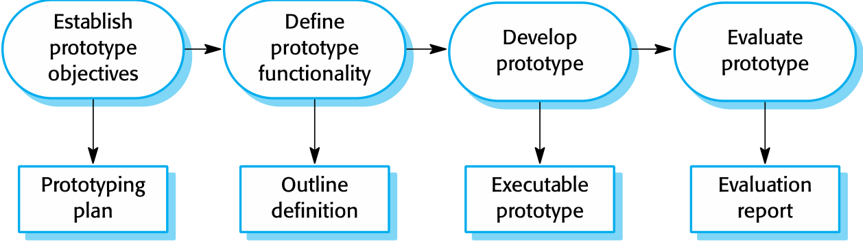
The process of prototype development
Chapter 2 Software Processes

Slide 42
Prototype development
May be based on rapid prototyping languages or tools
May involve leaving out functionality
Prototype should focus on areas of the product that are not well-understood
Error checking and recovery may not be included in the prototype
Focus on functional rather than non-functional requirements such as reliability and security
Chapter 2 Software Processes

Slide 43
Throw-away prototypes
Prototypes should be discarded after development as they are not a good basis for a production system:
It may be impossible to tune the system to meet non-functional requirements
Prototypes are normally undocumented
The prototype structure is usually degraded through rapid change
The prototype probably will not meet normal organizational quality standards
Chapter 2 Software Processes

Slide 44
Incremental delivery
Rather than deliver the system as a single delivery, the development and delivery is broken down into increments with each increment delivering part of the required functionality
User requirements are prioritized and the highest priority requirements are included in early increments
Once the development of an increment is started, the requirements are frozen though requirements for later increments can continue to evolve
Chapter 2 Software Processes

Slide 45
Incremental development and delivery
Incremental development (see earlier Software Process Model #3 – slides 10 and 14-16)
Develop the system in versions
Can work on parallel versions
Improved user/customer involvement (as compared with waterfall)
Incremental delivery (considered Software Process Model #4)
Deploy an increment for use by end-users
More realistic evaluation about practical use of software
Difficult to implement for replacement systems as increments have less functionality than the system being replaced
Used in agile development
Chapter 2 Software Processes

Slide 46
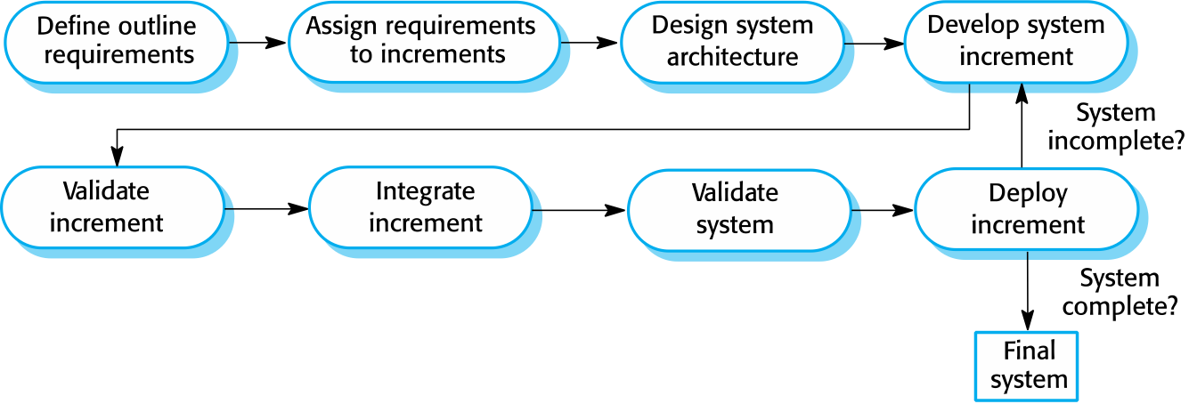
Incremental delivery
Chapter 2 Software Processes

Slide 47
Incremental delivery advantages
Customer value can be delivered with each increment so system functionality is available earlier
Early increments act as a prototype to help elicit requirements for later increments
Lower risk of overall project failure
The highest priority system services tend to receive the most testing
Chapter 2 Software Processes

Slide 48
Incremental delivery problems
Most systems require a set of basic facilities that are used by different parts of the system
As requirements are not defined in detail until an increment is to be implemented, it can be hard to identify common facilities that are needed by all increments
The essence of iterative processes is that the specification is developed in conjunction with the software
However, this conflicts with the procurement model of many organizations, where the complete system specification is part of the system development contract
Chapter 2 Software Processes

Slide 49
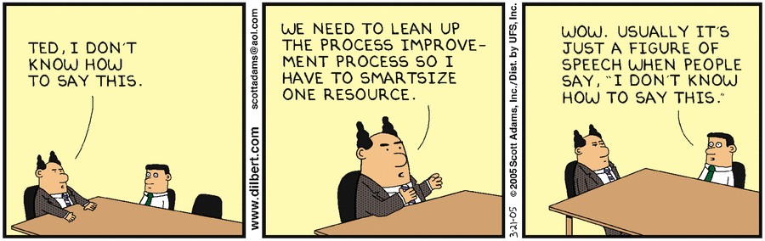
Process improvement
Chapter 2 Software Processes

Slide 50
Process improvement
Many software companies have turned to software process improvement as a way of enhancing the quality of their software, reducing costs or accelerating their development processes
Process improvement means understanding existing processes and changing these processes to increase product quality and/or reduce costs and development time
Chapter 2 Software Processes
Notes:
Constant demand for industry for cheaper, better software, which has to be delivered to ever-tighter deadlines

Slide 51
Approaches to improvement
The process maturity approach, which focuses on improving process and project management and introducing good software engineering practice
The level of process maturity reflects the extent to which good technical and management practice has been adopted in organizational software development processes
The agile approach, which focuses on iterative development and the reduction of overheads in the software process
The primary characteristics of agile methods are rapid delivery of functionality and responsiveness to changing customer requirements
Chapter 2 Software Processes

Slide 52
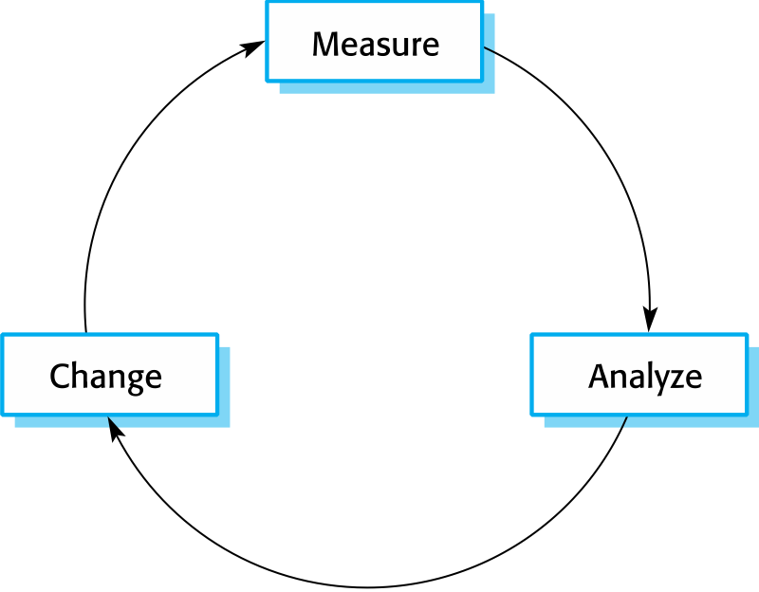
The process improvement cycle
Chapter 2 Software Processes

Slide 53
Process improvement activities
Process measurement
You measure one or more attributes of the software process or product. These measurements forms a baseline that helps you decide if process improvements have been effective.
Process analysis
The current process is assessed, and process weaknesses and bottlenecks are identified. Process models (sometimes called process maps) that describe the process may be developed.
Process change
Process changes are proposed to address some of the identified process weaknesses. These are introduced and the cycle resumes to collect data about the effectiveness of the changes.
Chapter 2 Software Processes

Slide 54
Process measurement
Wherever possible, quantitative process data should be collected
However, where organizations do not have clearly defined process standards this is very difficult as you don’t know what to measure. A process may have to be defined before any measurement is possible.
Process measurements should be used to assess process improvements
But this does not mean that measurements should drive the improvements. The improvement driver should be the organizational objectives.
Chapter 2 Software Processes

Slide 55
Process metrics
Time taken for process activities to be completed
E.g., calendar time or effort to complete an activity or process
Resources required for processes or activities
E.g., total effort in person-days
Number of occurrences of a particular event
E.g., number of defects discovered.
Chapter 2 Software Processes

Slide 56
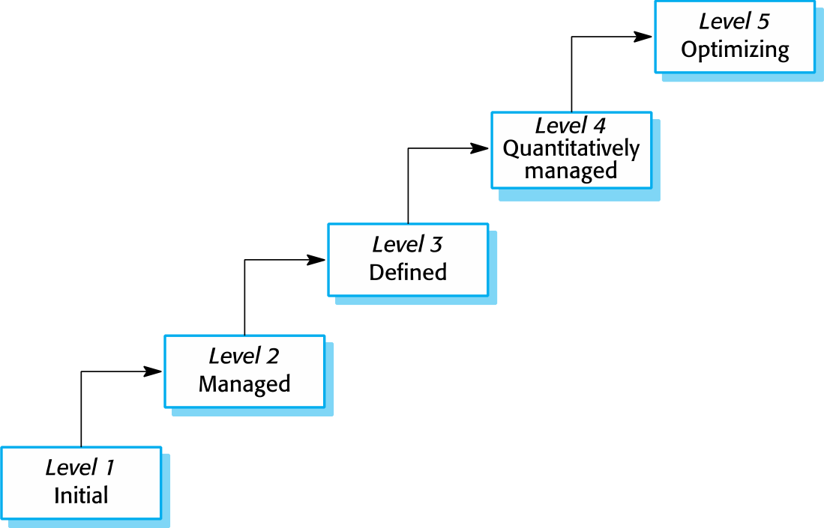
Capability maturity levels
Chapter 2 Software Processes

Slide 57
The SEI capability maturity model
Initial
Essentially uncontrolled
Repeatable
Product management procedures defined and used
Defined
Process management procedures and strategies defined and used
Managed
Quality management strategies defined and used
Optimizing
Process improvement strategies defined and used
Chapter 2 Software Processes

Slide 58
Key points
Software processes are the activities involved in producing a software system. Software process models are abstract representations of these processes.
General process models describe the organization of software processes
Examples of these general models include the ‘waterfall’ model, incremental development, reuse-oriented development, and incremental delivery
Requirements engineering is the process of developing a software specification
Chapter 2 Software Processes

Slide 59
Key points
Design and implementation processes are concerned with transforming a requirements specification into an executable software system
Software validation is the process of checking that the system conforms to its specification and that it meets the real needs of the users of the system
Software evolution takes place when you change existing software systems to meet new requirements. The software must evolve to remain useful
Processes should include activities such as prototyping and incremental delivery to cope with change
Chapter 2 Software Processes

Slide 60
Key points
Processes may be structured for iterative development and delivery so that changes may be made without disrupting the system as a whole
The principal approaches to process improvement are agile approaches, geared to reducing process overheads, and maturity-based approaches based on better process management and the use of good software engineering practice
The SEI process maturity framework identifies maturity levels that essentially correspond to the use of good software engineering practice
Chapter 2 Software Processes

